Slide 1
Truss Lab Report Group 2
Juddo Abakar
Tyler Schultz
Matthew Ernst

Slide 2
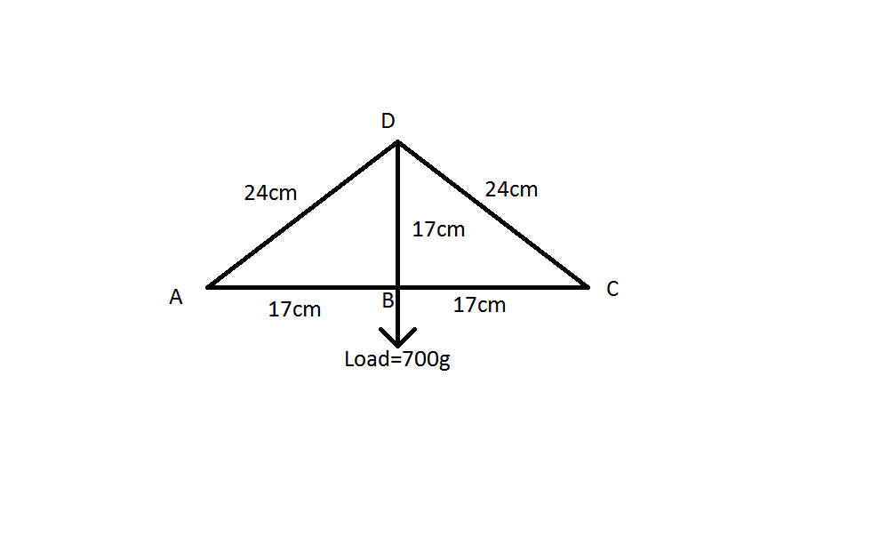
Objective
The purpose of this lab was to build a truss similar to problem 6-5 in the book. We would measure and calculate the force in the truss members DC, AB, and BC. The objective is to compare the calculated results of the forces with the experimental results.

Slide 3
Equipment used
Five truss member parts: Three “4” members, and two “5” members
4 members = 17cm
5 members = 24cm
Three load cells
Three weights: 1 kg, 0.5 kg, 0.2 kg

Slide 4
Procedure
Find the force in the truss members using analytical methods.
Use the load cells and weights to measure the force.
Compare calculated and experimental results.

Slide 5
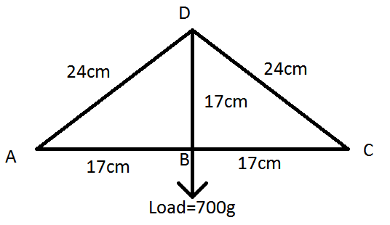
Results (calculated)
700g=6.86N
500g=4.90N
1000g=9.81N
Ay(0.34m)-6.86N(0.17m)=0; Ay=3.43N
3.43N(0.17m)-Fab(0.17m)=0; Fab=-3.43N=Fbc
-3.43N+6.86N-(0.17m/0.24m)Fdc=0; Fdc=4.84N
Using the same formulas but substituting different force values:
For 4.90N: Fab=Fbc=-2.45N, Fdc=3.46N
For 9.81N: Fab=Fbc=-4.905N, Fdc=6.92N

Slide 6
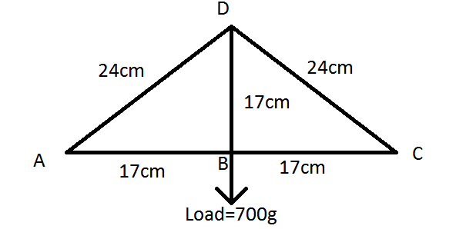
Results (experimental)
When we applied three load cells in members DC, AB, and BC, here were the recorded values:
700g=-3.23N (Fab), -3.24N (Fbc), 3.36N(Fdc)
500g=-2.23N (Fab), -2.19N (Fbc), 3.16N(Fdc)
1000g=-4.54N (Fab), -4.58N (Fbc), 6.49N(Fdc)

Slide 7
Conclusions
The calculated values of the lab were larger, but still very similar to, the experimental values of the lab. The values of the forces were both within the same number range and were still close to the expected values. The only value that did not match was for member DC with 700g; the calculated value was 4.84N and the experimental value was 3.36N. This along with other variations of the values could have been caused by rounding errors, estimation and approximation of the recorded numbers.

